Slide 1
What Actions are Needed for Understanding Human Actions in Videos? Gunnar A. Sigurdsson, Olga Russakovsky, Abhinav Gupta [ICCV2017]
Vision and Learning Reading Group
Presented by Jinwoo Choi
Aug 30, 2017

Slide 2
Computer Vision Problem History
Great Success!
This paper
Images (Objects)
Classification (Image-level supervision)
Object Detection (Bound box-level supervision)
Image Captioning/VQA
Videos (Activities)
Classification
Action Detection
Video Captioning/Story Telling

Slide 3
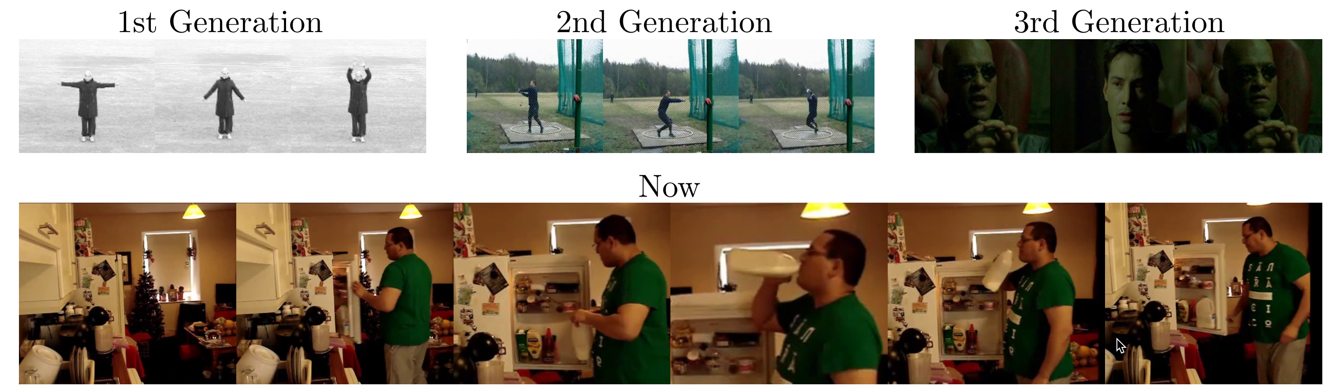
Datasets on Activity Recognition
: KTH
: UCF101
: HMDB51
: Charades
This paper
Notes:
KTH: simple motions with static background
UCF101: more complex actions from sports videos
HMDB: isolated activities in movies
Charades: cluttered sequences of home activities with many many annotations such as walks to the kitchen, opens the fridge, grabs some milk, opens the bottle, drinks from the bottle, puts it back and closes the fridge

Slide 4
Most evaluations are on charades in this paper
Because…
The most recent action recognition dataset
9.8k videos
157 activity classes
Temporal annotations
From the same group

Slide 5
Baselines evaluated
Two-Stream [Simonyan and Zisserman, NIPS14]
Improve Dense Trajectories [Wang and Schimid, ICCV13]
CNN + LSTM [Ng et al, CVPR15]
ActionVLAD [Girdhar et al, CVPR17]
Asynchronous Temporal Fields [Sigurdsson et al, CVPR17]
Notes:
ActionVLAD with some sophisticated spatio-temporal pooling
Asynchronous Temporal Fields with a deep structured model. CRF modeling for high-level reasoning.

Slide 6
What are the right activity categories?
“Take” vs. “Take medication”
(verb, noun) pairs are more distinctive than verbs alone
Validated by an Amazon Mechanical Turk study
“holding a cup” vs “holding a broom,” : 0.3% of the time confusion
“holding a cup” vs “drinking from a cup,” : 1.3% of the time confusion
So we define an action as (verb, noun) pair
“Take medication”
Notes:
That is, given the verb, workers confused activities with different objects, e.g., “holding a cup” vs “holding a broom,” only 0.3% of the time. However given the ob- ject, there was more confusion among different verbs, e.g., “holding a cup” vs “drinking from a cup,” 1.3% of the time.

Slide 7
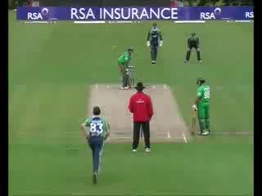
Do activities have temporal extents?
Object shows clear boundary
Determining “when” of an activity is ambiguous
Amazon Mechanical Turk study
Measure the agreement of temporal boundary between the new annotation and GT
IoU (Intersection over Union) criterion

Slide 8
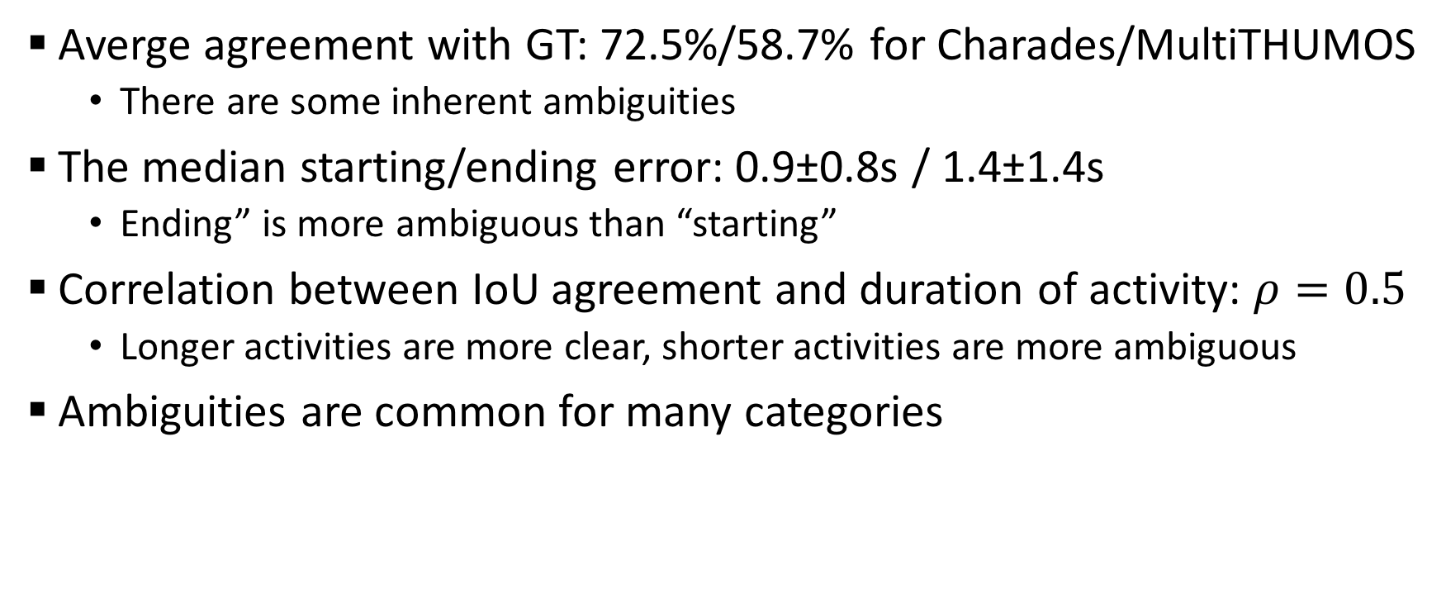
Observations
Averge agreement with GT: 72.5%/58.7% for Charades/MultiTHUMOS
There are some inherent ambiguities
The median starting/ending error: 0.9±0.8s / 1.4±1.4s
Ending” is more ambiguous than “starting”
Correlation between IoU agreement and duration of activity: $ρ=0.5$
Longer activities are more clear, shorter activities are more ambiguous
Ambiguities are common for many categories
Notes:
They looked at how well human annotators agreed with the activity boundaries by asking Amazon Mechanical Turkers to re-annotate the extent of actions in the Charades and MultiTHUMOS datasets.

Slide 9
So, can we evaluate temporal localization?
Yes
Relaxed condition study
Ignore the boundary region of activities (evaluate only on center 1/3)
Average agreement: 79.8% (72.5% when evaluate on the full region)
Relaxed condition does not change the order of the performances of the methods
Despite the ambiguities, we can learn from and evaluate the temporal extents of activities

Slide 10
Should we evaluate temporal localization?
No, in this paper
Charades average duration: 30.1sec
Short videos
Perfect video classifier gives 56.9% temporal localization mAP
5 times better than two-stream method (two-stream 9.6%)
Measured how well a perfect video classifier emitting the same binary prediction for every frame

Slide 11
Recap
Should focus on (verb,object) pairs not just verbs
Temporal boundaries of activities are still meaningful (despite of some ambiguities)
Should focus on classification not localization

Slide 12
What are existing approaches learning?
Several aspects
Error analysis
Data analysis
Temporal reasoning analysis
Person-based reasoning analysis
Evaluation on Charades dataset
mAP – attribute plot analysis

Slide 13
Baselines used
Two-Stream [Simonyan and Zisserman, NIPS14]
Improve Dense Trajectories [Wang and Schimid, ICCV13]
CNN + LSTM [Ng et al, CVPR15]
ActionVLAD [Girdhar et al, CVPR17]
Asynchronous Temporal Fields [Sigurdsson et al, CVPR17]
Notes:
Two-stream: late fusion of RGB CNN and Flow CNN
IDT: feature tracking + SURF descriptor
CNN + LSTM: use LSTM for sequence modeling
ActionVLAD with sophisticated spatio-temporal pooling
Asynchronous Temporal Fields with a deep structured model. CRF modeling for high-level reasoning.

Slide 14
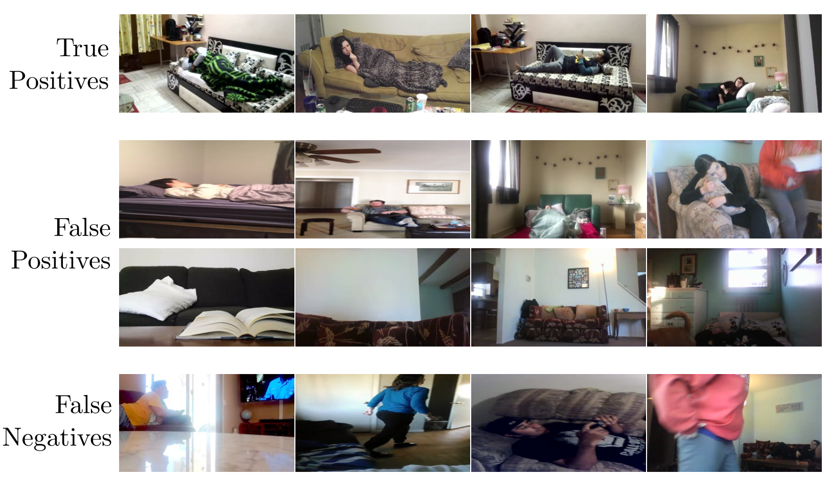
GT label: “lying on a couch”
Notes:
Example results from a Two-stream network on per-frame classification of the “Lying on a couch” action in Charades. a) High-scoring true positives commonly include canonical views of both a couch and a person. Top false positives often include b) confusion with other objects (e.g., beds) or verbs (e.g., sitting) and c) the correct scene but with an absent action (e.g., vacant couches). d) Top false negatives include unusual viewpoints.

Slide 15
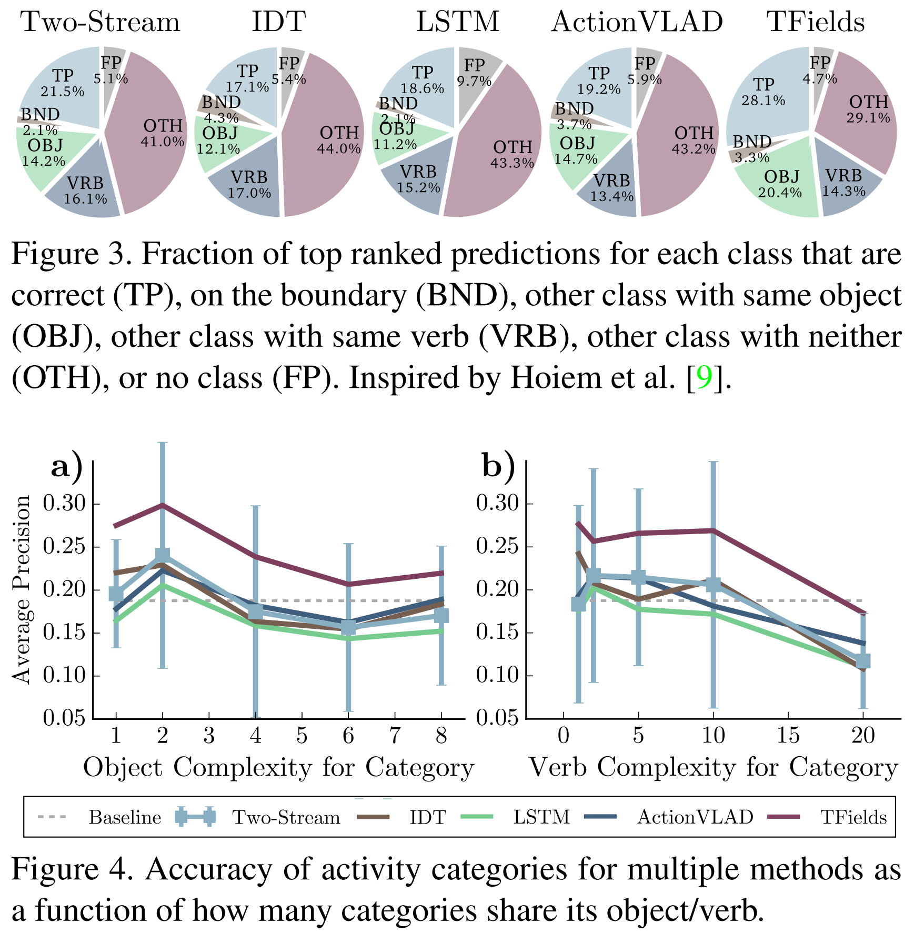
Error analysis
TP: correct
BND: on the boundary
OBJ: other class with same object
VRB: other class with same verb
OTH: other class with neither same object nor same verb
FP: no class
Notes:
First, we note that not many errors are made close to the boundary. However, we can see that significant confusion is among similar categories, both for verbs and objects, interestingly TFields [30] confuse unrelated categories much less (29.1% compared to 41.0 − 44.0%), but at the cost of confusing categories with similar object.
In fact, for a given category the more categories share the object or verb, the worse the accuracy. This is visualized in the next figure

Slide 16
Error analysis
More categories share the object/verb, the worse performance
Fine-grained discrimination between similar objects and verbs could help action recognition
Notes:
Performance vs how many categories share an object/verb with the given category (Object/Verb complexity). In order to improve action recognition, fine-grained discrimination between activities with similar objects and verbs is needed.

Slide 17
Training data analysis
Are current methods limited by the data?
E.g. imbalance, similar categories
Naïve experiment: train on 100%, 70%, 30% of the train set
15.6%, 14.7%, 11.6% mAP

Slide 18
Training data analysis: small categories
Small categories (# of data is low)
Limit all categories have # of examples <100
More similar categories (sharing many same objects/verbs) shows more mAP drop
Need to be careful for this categories when balancing the dataset
More challenging to learn

Slide 19
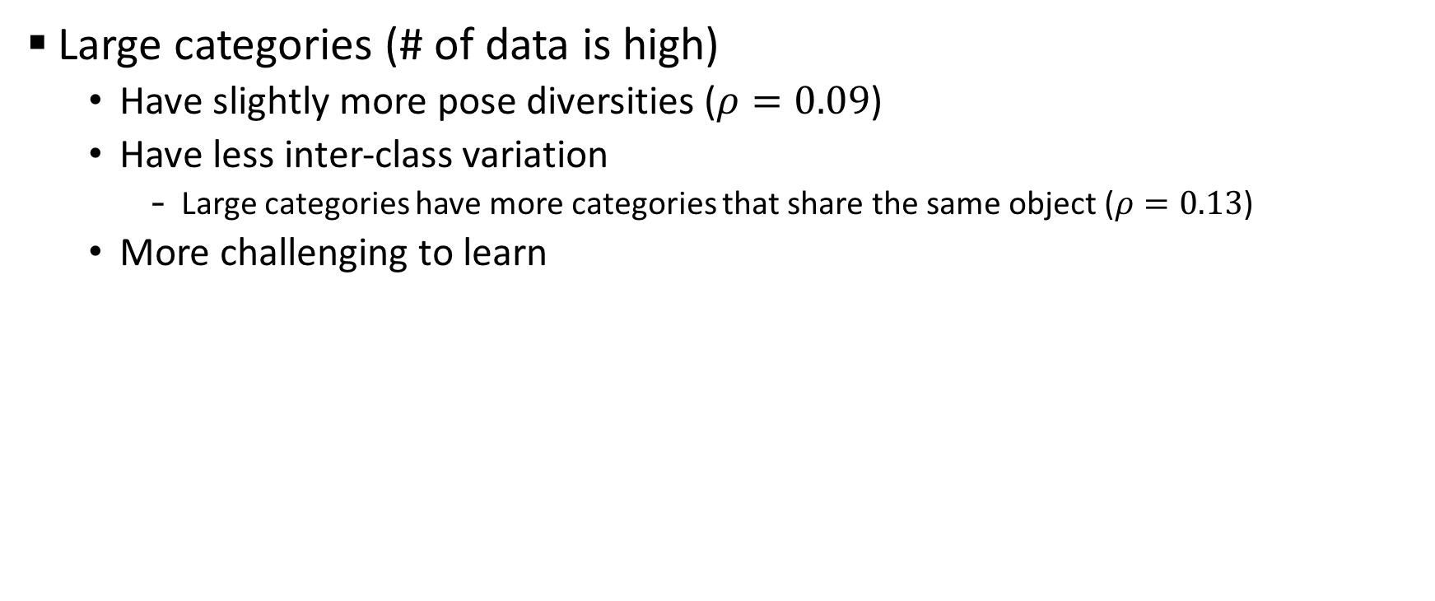
Training data analysis: large categories
Large categories (# of data is high)
Have slightly more pose diversities ($ρ=0.09$)
Have less inter-class variation
Large categories have more categories that share the same object ($ρ=0.13$)
More challenging to learn

Slide 20
Temporal reasoning analysis
Evaluation with different granularities
Motion: average amount of optical flow in a given category
Continuity: average temporal extent of activities in each category
Temporal context: how many other actions increase the prediction confidence of the desired action by being present in a video

Slide 21
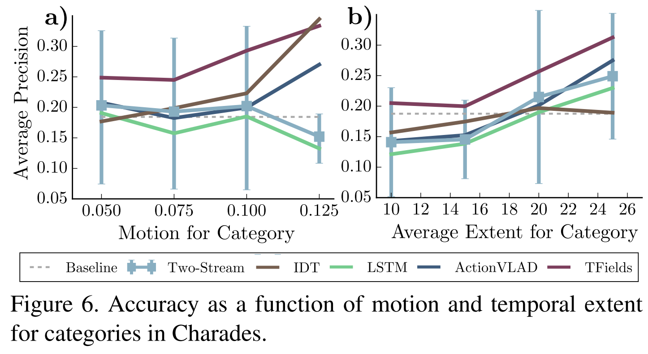
Effect of motion and continuity
Current methods are better at modeling longer activities than short ones
More research needed for short activities

Slide 22
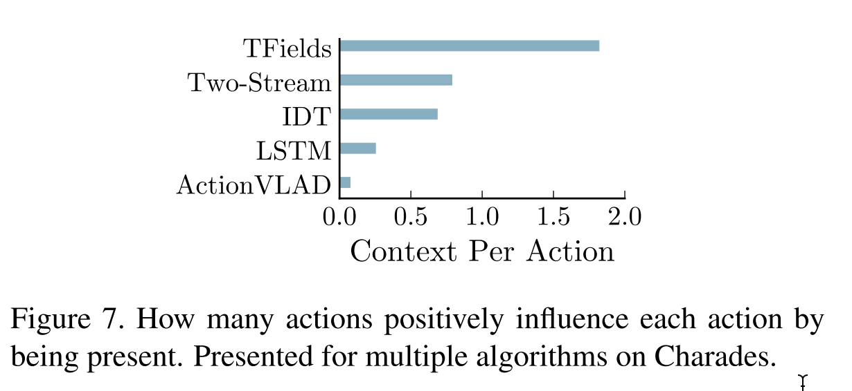
Temporal reasoning analysis
High level reasoning method (TFields) benefits much from the temporal context
Other methods naively use temporal context
e.g. Two-stream late fuses predictions on sampled frames

Slide 23
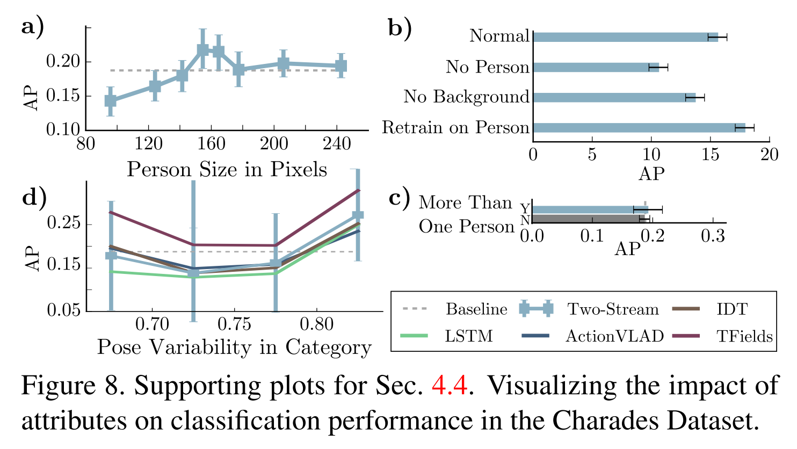
Person-based reasoning
Person size
Mid-sized person is recognized well
Having multiple people in the video
Does not affect the performance significantly
Ablative study
Removing person affects more than removing background
Retrain on person improves performance
Person-focused reasoning may be beneficial to current algorithms
Notes:
We removed the person from the scene (No Person) and then removed everything but the person from the scene (No Background) and evaluated the network accuracy. The removal was done by using the same Faster-RCNN bounding box detection and by setting all removed pixels to the average value. In Fig. 8b, we can see that removing the person from the test images does more damage than removing other parts of the image. Finally, we retrain the Two-stream network [32] on only the cropped image of the person (Retrain on Person). Retraining on the cropped image yields a noticeable improvement in accuracy (15.6% to 17.9% mAP). This suggests that person-focused reasoning may be beneficial to current algorithms

Slide 24
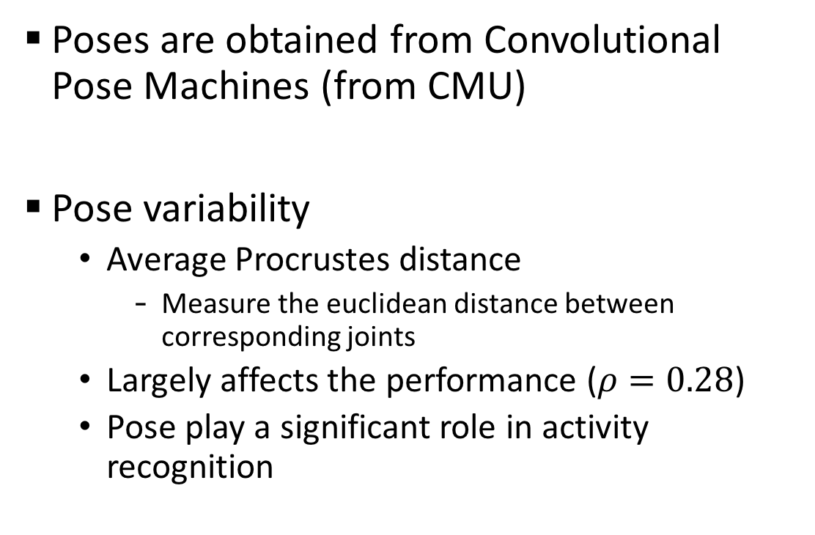
Pose-based reasoning
Poses are obtained from Convolutional Pose Machines (from CMU)
Pose variability
Average Procrustes distance
Measure the euclidean distance between corresponding joints
Largely affects the performance ($ρ=0.28$)
Pose play a significant role in activity recognition

Slide 25
So, what’s next?
Oracle experiments
Perfect Object: list of objects presented in the test video is given
Perfect Verb: list of verbs presented in the test video is given
Perfect Temporal: end time of the last activity, start time of the next activity are given
Perfect Intent: which intent cluster the video correspond to is given
Perfect Pose: which pose cluster the video correspond to is given
Use two-stream video classifier with oracles
Notes:
Perfect temporal: From the video annotations we learn the distribution of activities that is likely occur in this frame given this information. This produces a probability distribution of actions in each frame; we max-pool over all frames to obtain predictions for the entire video.
Perfect Intent Oracle: Each video contains multiple labels. When thinking about Intent we can imagine that these labels occur together in certain ways. For example, “put on clothes” “put on shoes” “open door”, might be associated with the intent of leaving the house. We cluster the labels from all the videos into 30 or 50 clusters. Each intent cluster thus corresponds to a distribution of activities. A perfect intent oracle gives which cluster the video corresponds to. Given this cluster, the distribution of activities within the cluster is used as the activity prediction.
Each video can be thought of as a 157 dimensional vector with 0s and1s based on what categories are in the video. We cluster these vectors with cosine distance and spectral clustering.
Perfect Pose Oracle: We cluster the poses in all frames into 500 clusters. Given the cluster, the distribution of activities within the cluster is used as the activity prediction.

Slide 26
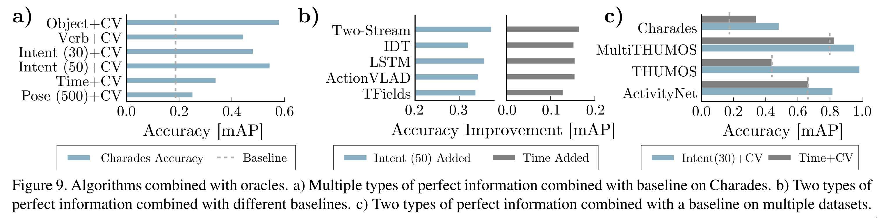
Oracle experiment
baseline
All of the oracles are beyond the baseline (Two-Stream)
There are much room for improvement
Object understanding is more important than temporal reasoning
Pose improvement is relatively small
Because motion is not incorporated

Slide 27
Oracle experiment: method comparison
Time
Two-stream gains most from oracle
No temporal information modeling beyond flow
Intent
IDT gains least from oracle
Trajectory may capture high-level information
Fusion of complementary algorithm would increase the performance

Slide 28
Oracle experiment: dataset comparison
Intent oracle
Baseline + oracle approaches perfect performance on THUMOS
Because of fewer categories (20)
Time oracle
Baseline + oracle gains improvement on Charades, MultiTHUMOS
No improvement on THUMOS, ActivityNet

Slide 29
Conclusion
Activities are ambiguous but we can still train a meaningful model for activity recognition
Activity classification is still an important problem
Object/Person based reasoning helps
High-level temporal context helps

Slide 30

Thank You!
Notes:
Thank you for listening. Any questions?

